Slide 1
THE DEVELOPMENT OF NEW YORK METROPOLITAN AREA
Gayaza High School
Geography Department

Slide 2
Location of New York Metropolitan area.
The New York metropolitan area includes New York City, Jersey City, Newark City, Yonkers city and Paterson city.
It is located in the Eastern part of the country at the Atlantic coast.
It covers parts of New York State, New Jersey State as well as small parts of Connecticut and Pennsylvania.

Slide 3
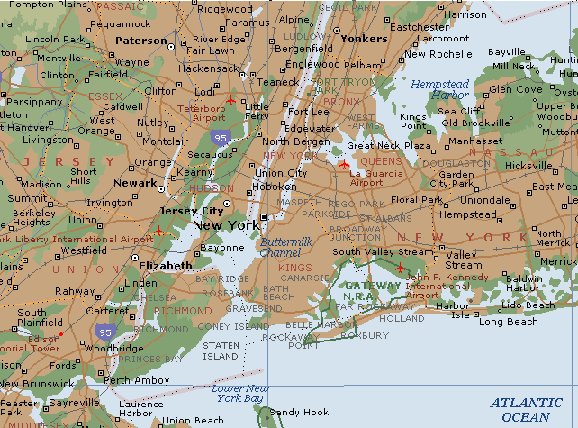
Map of New York metropolitan area

Slide 4
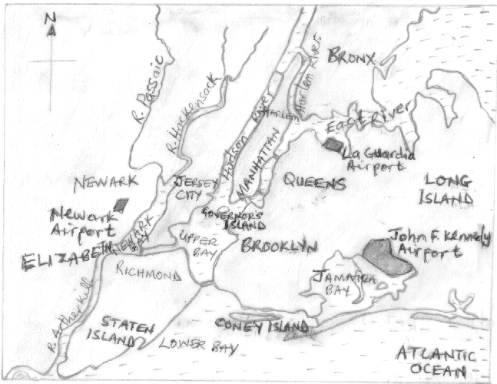
Sketch map of New York showing the major features

Slide 5
The site and relief of New York metropolitan area
The area is sited at the coast and on a number of Islands separated by rivers and bays.
The relief is generally flat or gently undulating.
The average height of land is 40 metres above sea level

Slide 6
The drainage features of New York metropolitan area.
The major rivers include Hudson River, East River, Harlem River, river Arthur kill, river Passaic and river Hackensack.
The bays include Upper bay, Lower bay, Newark bay and Jamaica bay.
other water bodies include the Atlantic Ocean and the Long Island sound.

Slide 7
New York City.
It is also the largest and most populous city in the U.S.A.
The city is sited on Manhattan, Staten Island, Long Island, Coney Island and Governors Island.
The boroughs of New York City include Manhattan, Queens, Brooklyn, Bronx and Staten Island.

Slide 8
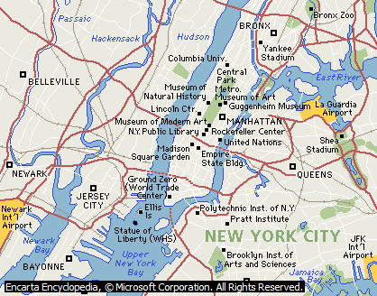
Map of New York City.

Slide 9
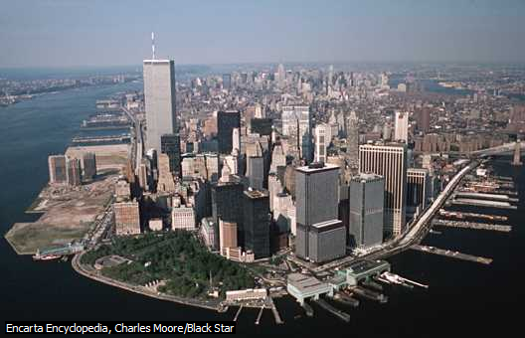
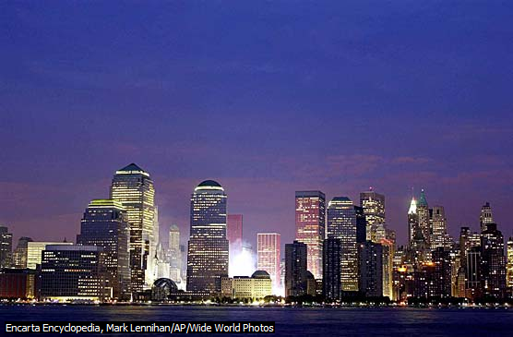
Images of New York City

Slide 10
Historical background of New York City
New York City originated as a Dutch settlement in 1624 as New Amsterdam.
In 1664, it was taken over by the British settlers who renamed it New York.
The population of the city continued to increase due to the Islands’ attractions to the immigrants.

Slide 11
The factors that attracted European settlers to Manhattan, New York
The warm climatic conditions .
The existence of fertile soils .
The existence of a natural harbour.
The strategic position .
It was relatively secure from hostile Red Indian tribesmen.
The existence of a gently sloping or rather flat land.

Slide 12
Reasons for the rapid growth and development of New York.
Its position as a port .
The increasing population in the area.
The suitable location of the area with easy access to raw materials .
New York port has ice free conditions .
Availability of market for goods manufactured in New York.
Availability of capital and easy access to finance.
The location or situation of the city at the end of the Hudson Mohawk gap.

Slide 13
FUNCTIONS OF NEW YORK CITY/ METROPOLITAN AREA
Transport and communication centre.
Industrial Centre.
Administrative centre.
Recreational and tourist centre.
Business and commercial centre.
Educational centre.
Medical/ health centre.
Religious and cultural centre.
Research centre.
Residential centre.

Slide 14
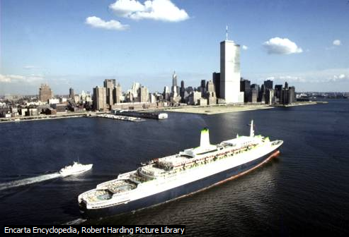
Queen Elizabeth II Cruise Liner approaching Manhattan

Slide 15
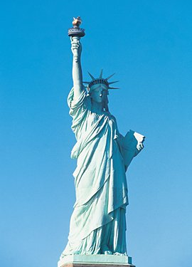
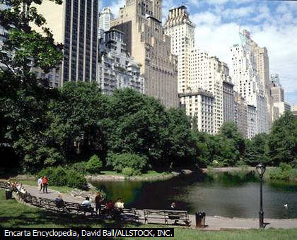
Statue of Liberty & the Central Park

Slide 16
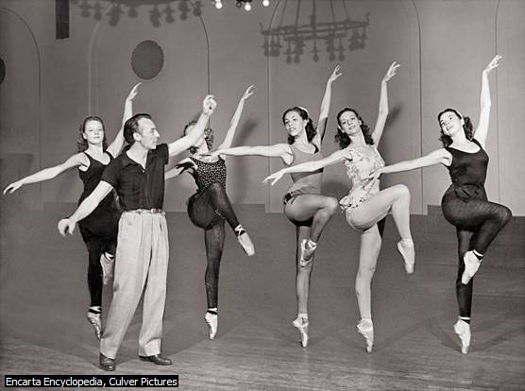
New York city ballet

Slide 17
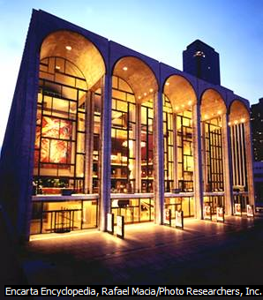
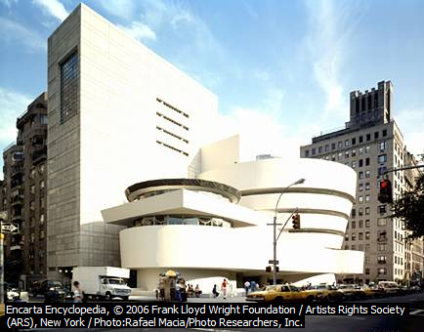
The Metropolitan opera house and Guggenheim Museum

Slide 18
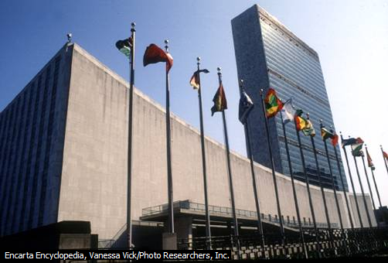
United Nations Headquarters

Slide 19
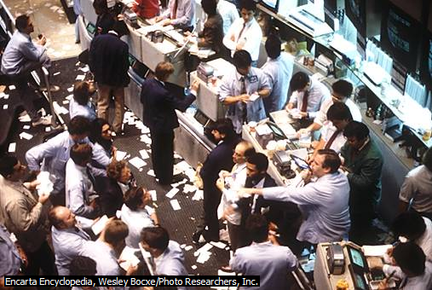
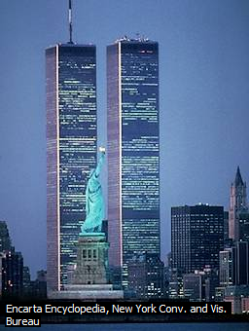
New York Stock Exchange & the World Trade Centre.

Slide 20
THE DEVELOPMENT OF NEW YORK PORT
New York Port is one of the largest ports in North America and handles almost half of North American trade.
It is a natural harbour.
A harbour refers to a sheltered stretch of water at a coastal area where ships can shelter and obtain protection from storms or tidal waves and currents.

Slide 21
Factors favouring New York port as a natural harbour
Deep waters of up to 14 metres.
Sheltered waters/ bays.
Low tidal range of about 2 metres.
Ice free conditions throughout the year.
Clear entrance into the harbour.
Hard rocks to construct quays and dock yards on a firm foundation.

Slide 22
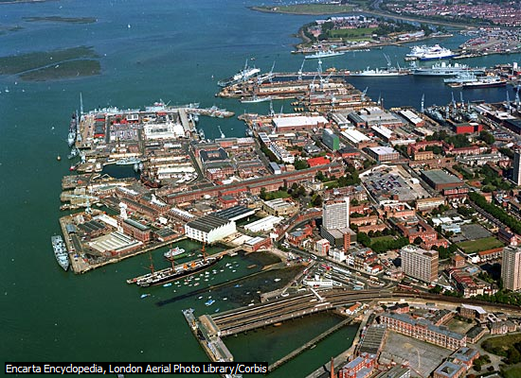
Examples of harbours
Notes:
Portsmouth Harbour.

Slide 23
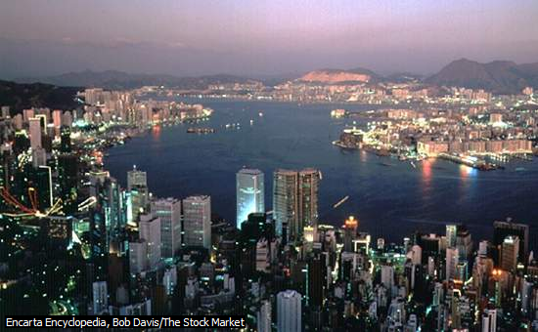
Notes:
Hong Kong Harbour.

Slide 24
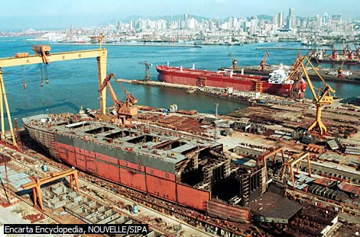
Notes:
Dalian’s Harbour

Slide 25
Factors that have favoured the development of New York port
Good physical conditions e.g. deep waters, low tidal range, ice free and sheltered conditions.
The port has a rich industrial and agricultural hinterland. A Hinterland is an area served by a port.
Availability of capital for the establishment of port facilities and use of containers.
Advanced technology has enabled the growth of the port.
Easy accessibility of the port from various places.

Slide 26
PORT FACILITIES
Dock: This refers to an enclosed area of water at a port where ships can be stationed be loaded, offloaded or repaired.
Dry dock: This is a dock from which water can be emptied. It is used for the repair and building of ships.
Quay: This refers to a place or platform constructed of concrete or wood beside a dock where goods are loaded and offloaded from a ship.

Slide 27
Dock yard: It is a place or area at a port with facilities for receiving ships as well as equipment or supplies for repairing or building ships.
Berths/ Wharves: These are sections at a dock where ships are anchored for loading and unloading of cargo.

Slide 28
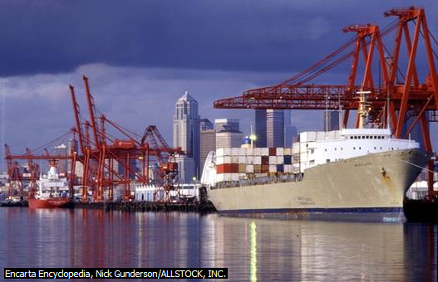
A Dock

Slide 29
Containerisation at the port of New York
Containerisation refers to the use of large standardized metallic boxes for the packing of cargo or goods to be transported when sealed.
Containerisation has developed at the port of New York and this has greatly facilitated water transport in the region.
Port Elizabeth which is well known for handling containers in New York.

Slide 30
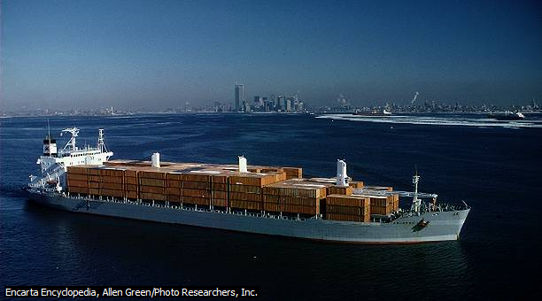
A Container ship

Slide 31
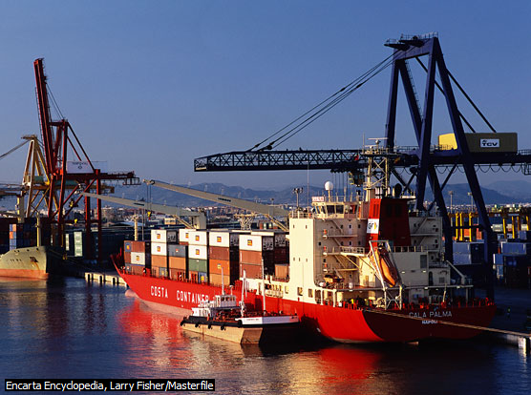
Unloading a Container Ship

Slide 32
Advantages of containerisation at New York port
Easy loading and unloading of cargo. This is due to the use of use of equipment like cranes.
Cargo is protected against bad weather.
protection of the goods against damage by insects or pests.
The cargo is protected against contamination by Pollutants.

Slide 33
Cargo is protected against loss through theft or carelessness.
It tends to be time saving i.e. less time is spent on loading and unloading as well as clearing of the goods.
The load capacity of vessels is increased i.e. more goods can be carried with containers.

Slide 34
Disadvantages of Containerisation
The use of containers results into the unemployment of stevedores or longshore men.
It is unsuitable for the transportation of small volume or quantities of freight (cargo).
It is quite expensive to acquire containers and to install container handling equipment or facilities like cranes.
Some containers tend to be rigid in application. They are meant only for a specific type of cargo.
It has resulted into overcrowding at the port.

Slide 35
Commodities handled by the port of New York
Exports handled:
Agricultural products e.g. wheat, corn, fruits, beef etc.
Textiles and a variety of clothing e.g. woolen, cotton, silk and synthetic textiles.
Iron and steel products e.g. vehicles, roofing material, household utensils etc.
Electrical appliances e.g. flat irons, cookers, refrigerators, television sets, radios etc.
Petro-chemical products e.g. plastics, paints, detergents, insecticides etc.

Slide 36
Imports handled by New York Port:
Minerals e.g. iron ore.
Forestry products e.g. wood pulp, plywood, timber etc.
Petroleum/ crude oil especially from the Middle East.
Agricultural products e.g. cotton, food crops for the food processing industries etc.

Slide 37
Problems facing the port of New York
Congestion and overcrowding of sea vessels and containers.
Occurrence of fog that tends to reduce on visibility.
Silting of the waters since the harbour is located at the river mouths.
Unexpected tidal changes.

Slide 38
Measures that have been taken to solve the problems of the port
Extension of dock facilities to create more space for maritime traffic.
The regulation of the traffic to avoid overcrowding.
The use of fog vision equipment and fog lights in order to avoid the possibilities of accidents.
Dredging of the silt.

Slide 39
THE PORT OF MOMBASA
Mombasa Port is located at the Kenyan coast of the Indian ocean. It is the largest and busiest port in East Africa.
It is sited on a natural harbour.
The main port city is sited on an Island i.e. Mombasa Island.
Mombasa harbour is sheltered by the Nyali and Likoni headlands.

Slide 40
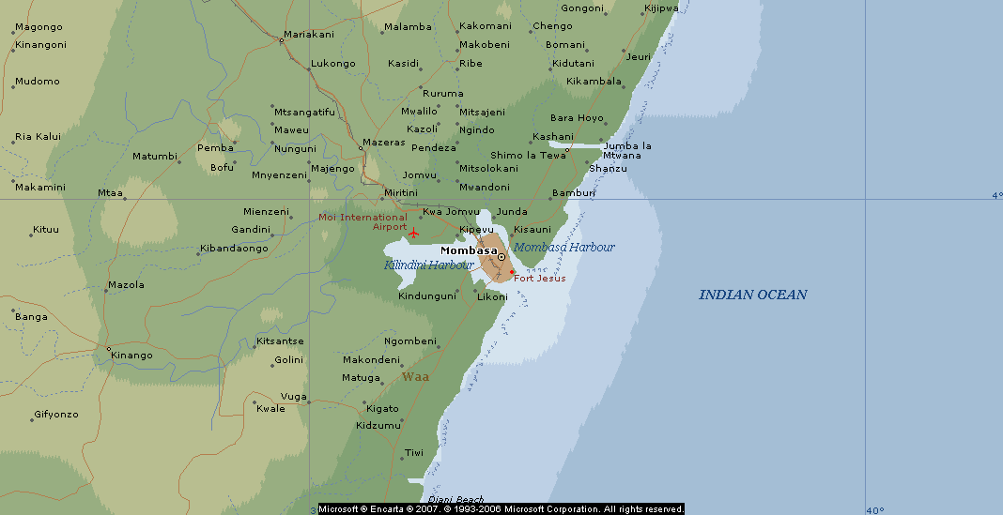
Map of Mombasa

Slide 41
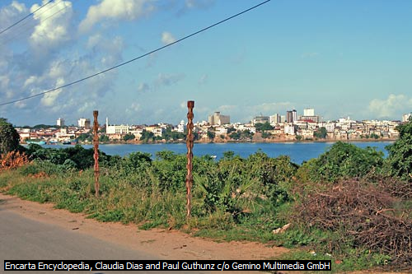
A view of Mombasa.

Slide 42
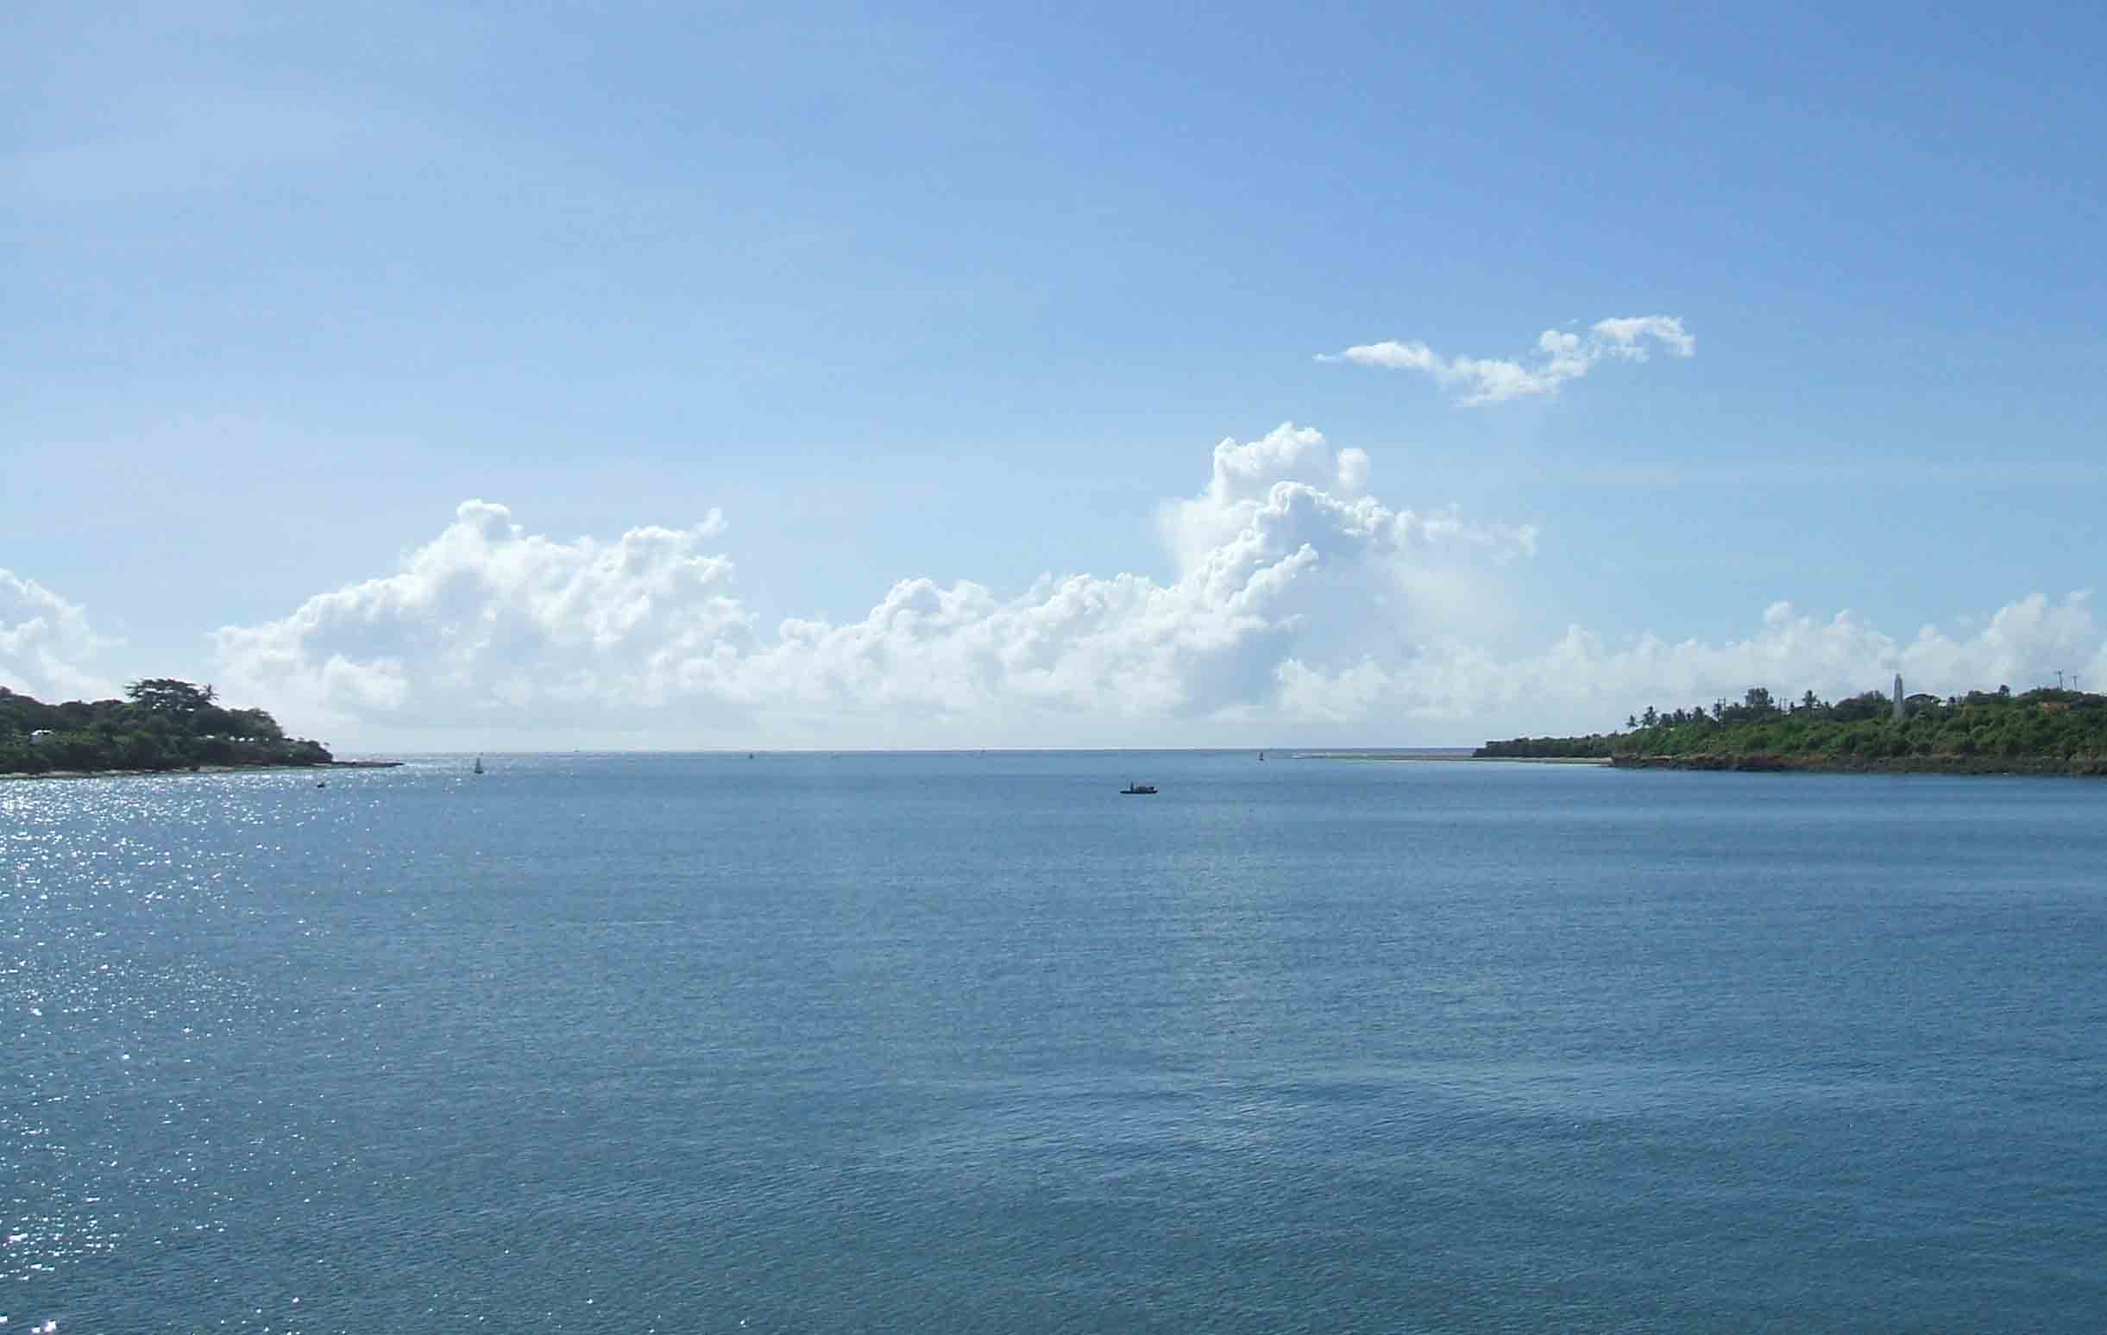
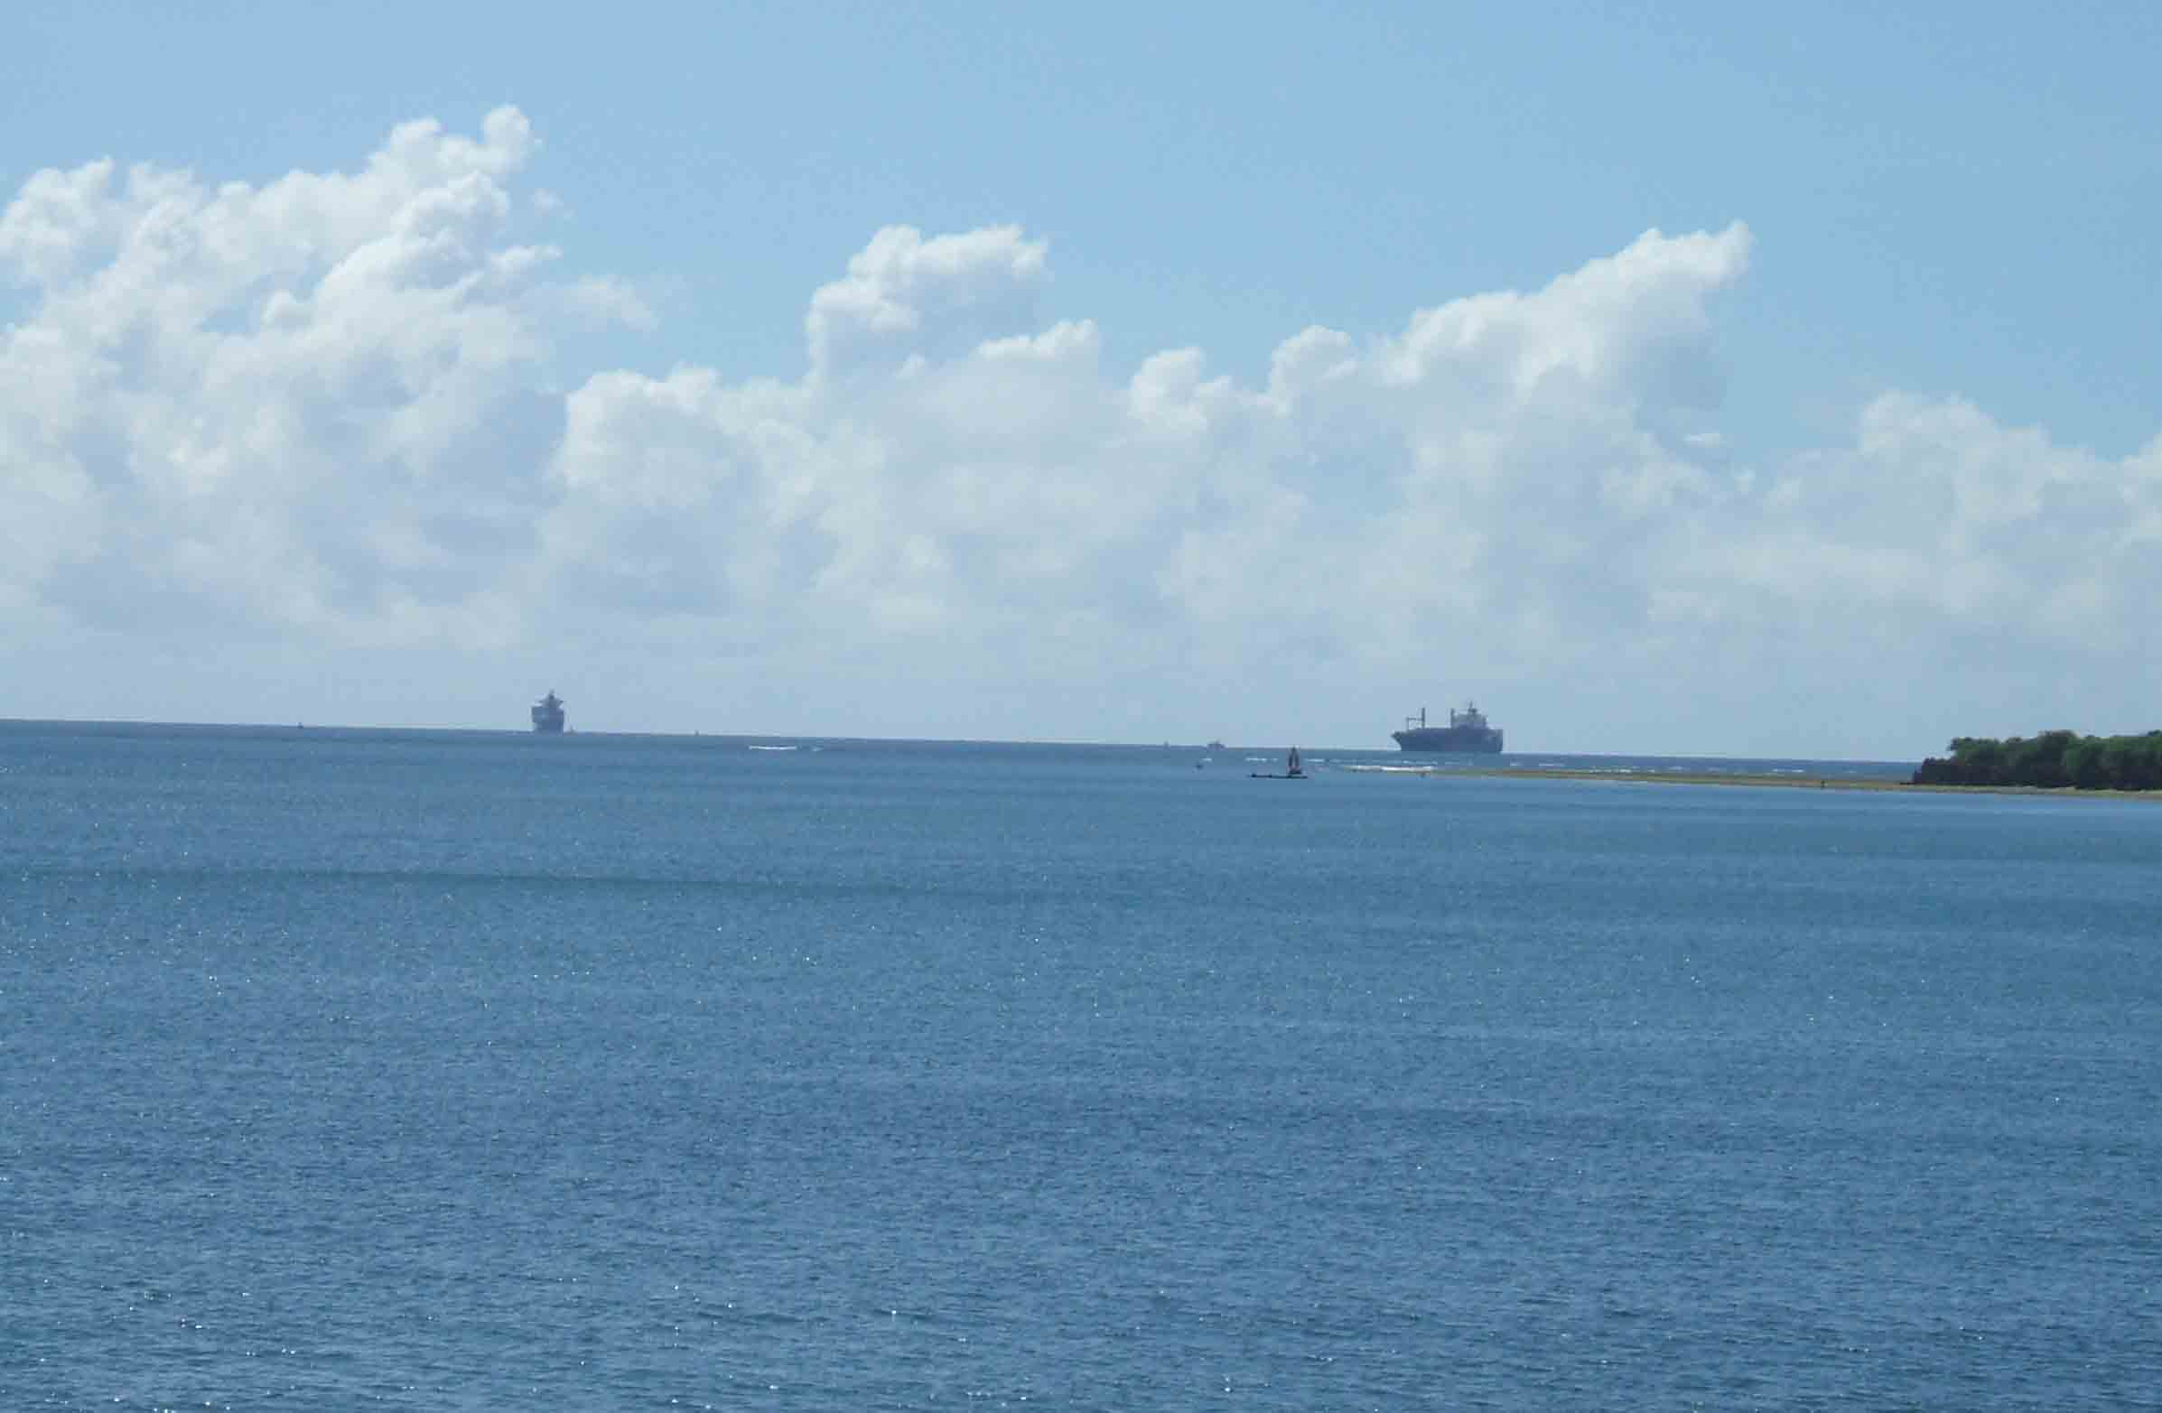
Entrance to Mombasa harbour

Slide 43
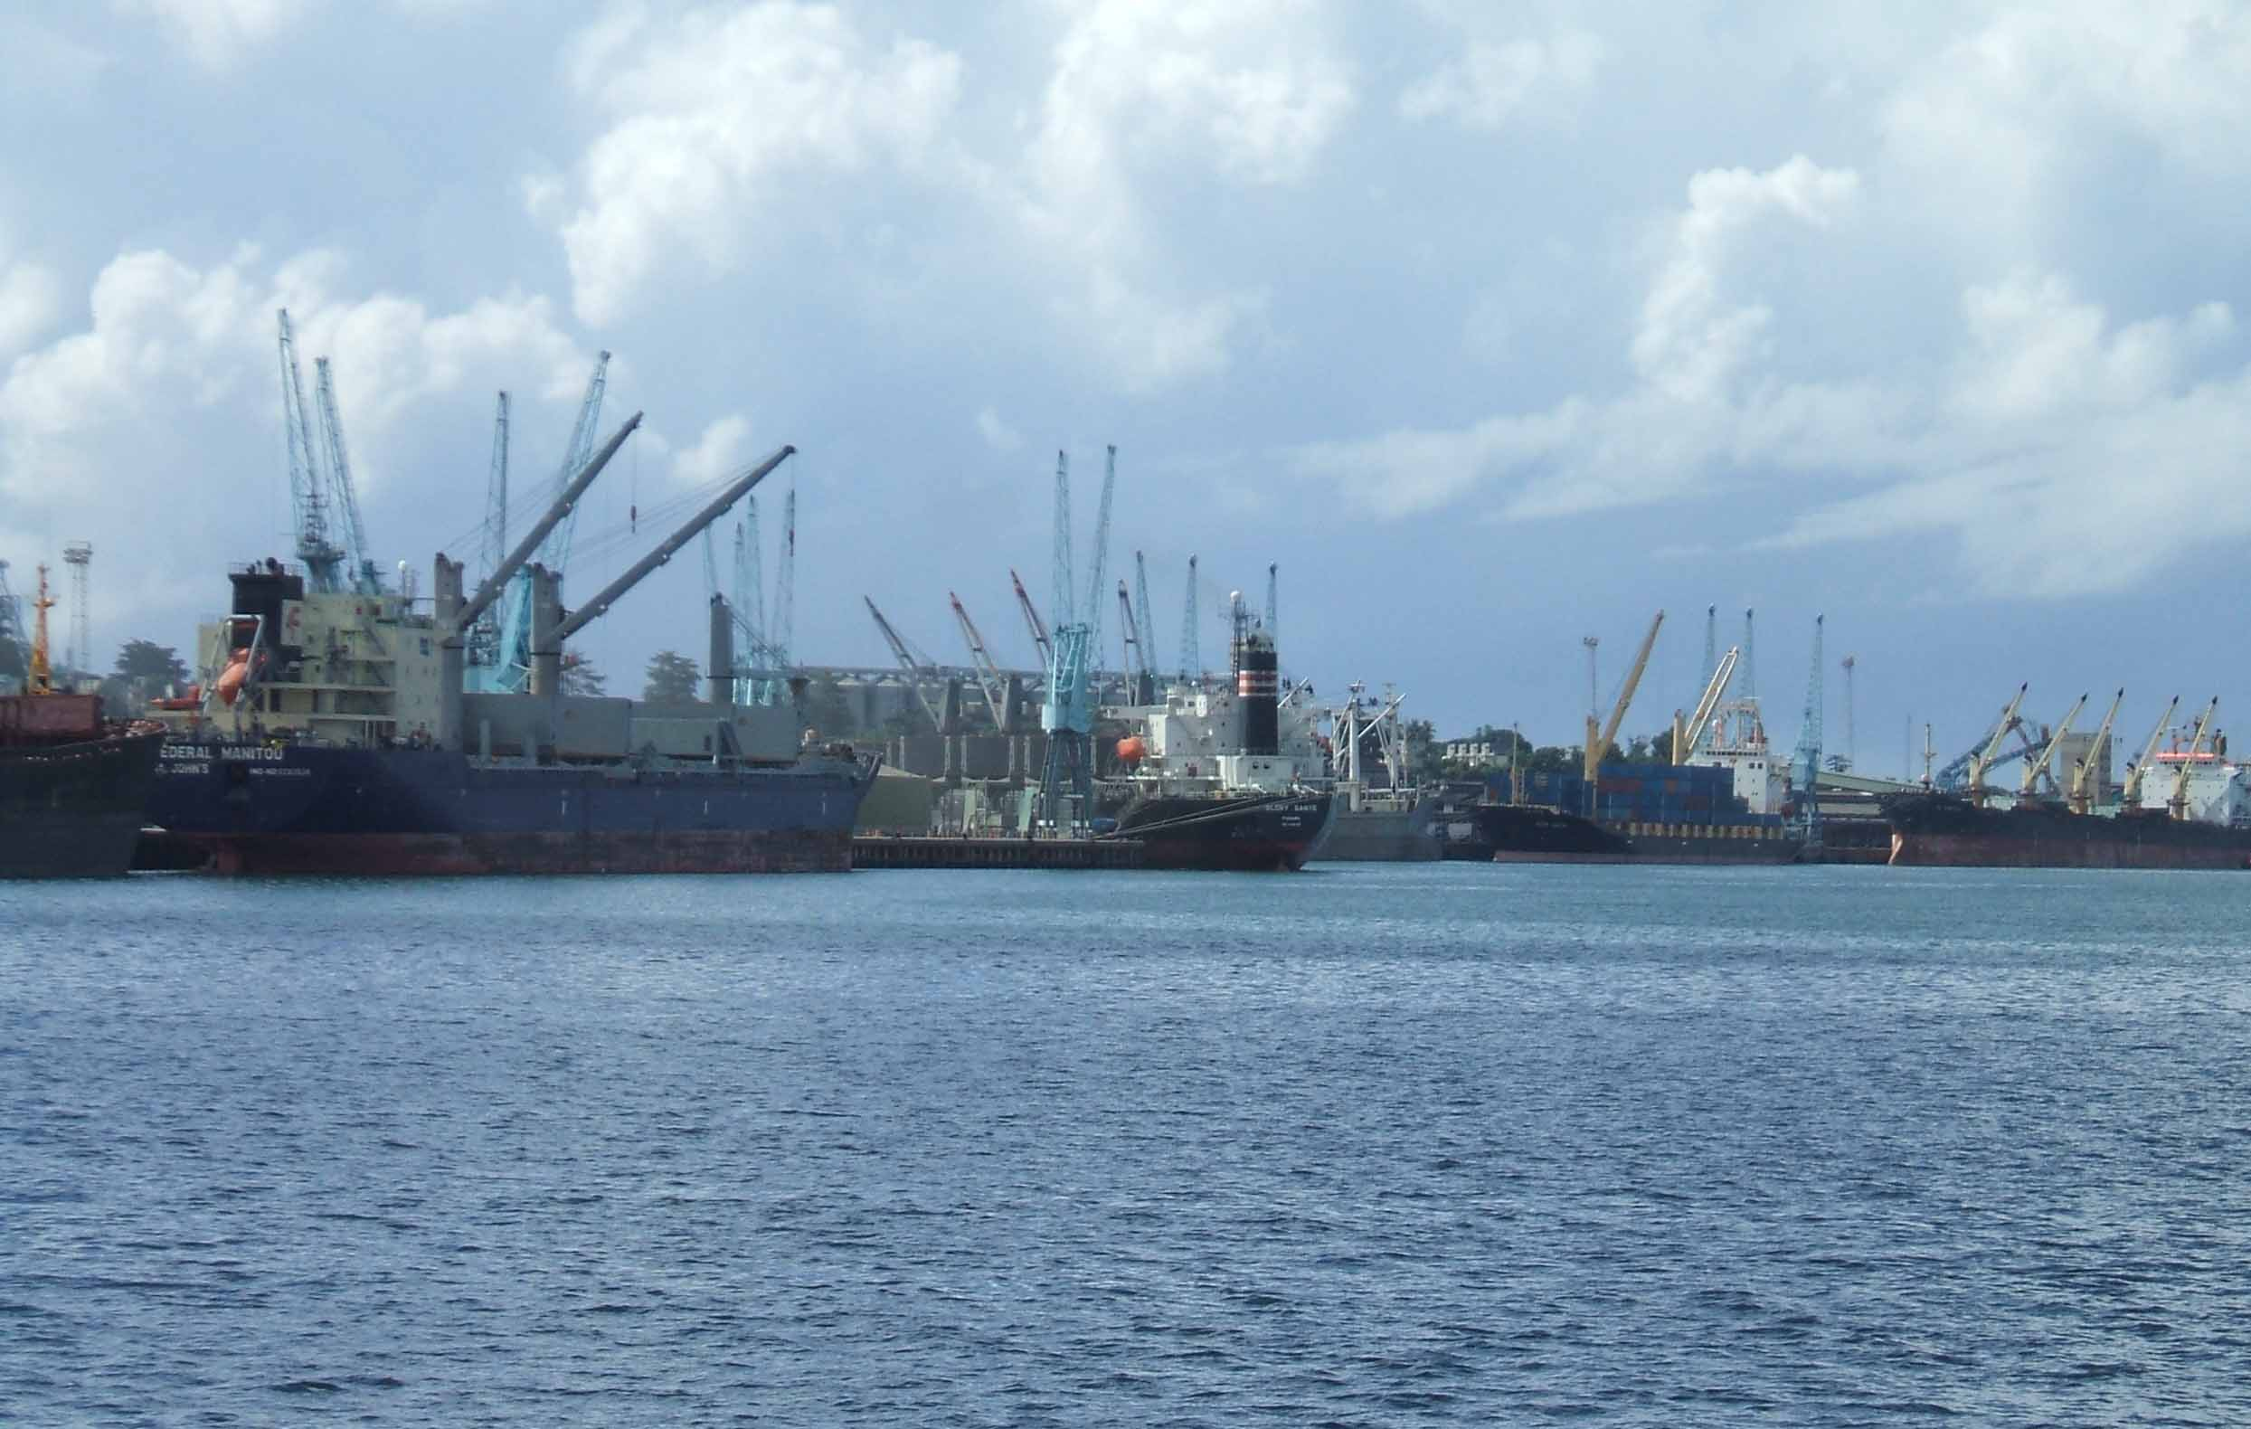
Docks at Mombasa harbour

Slide 44
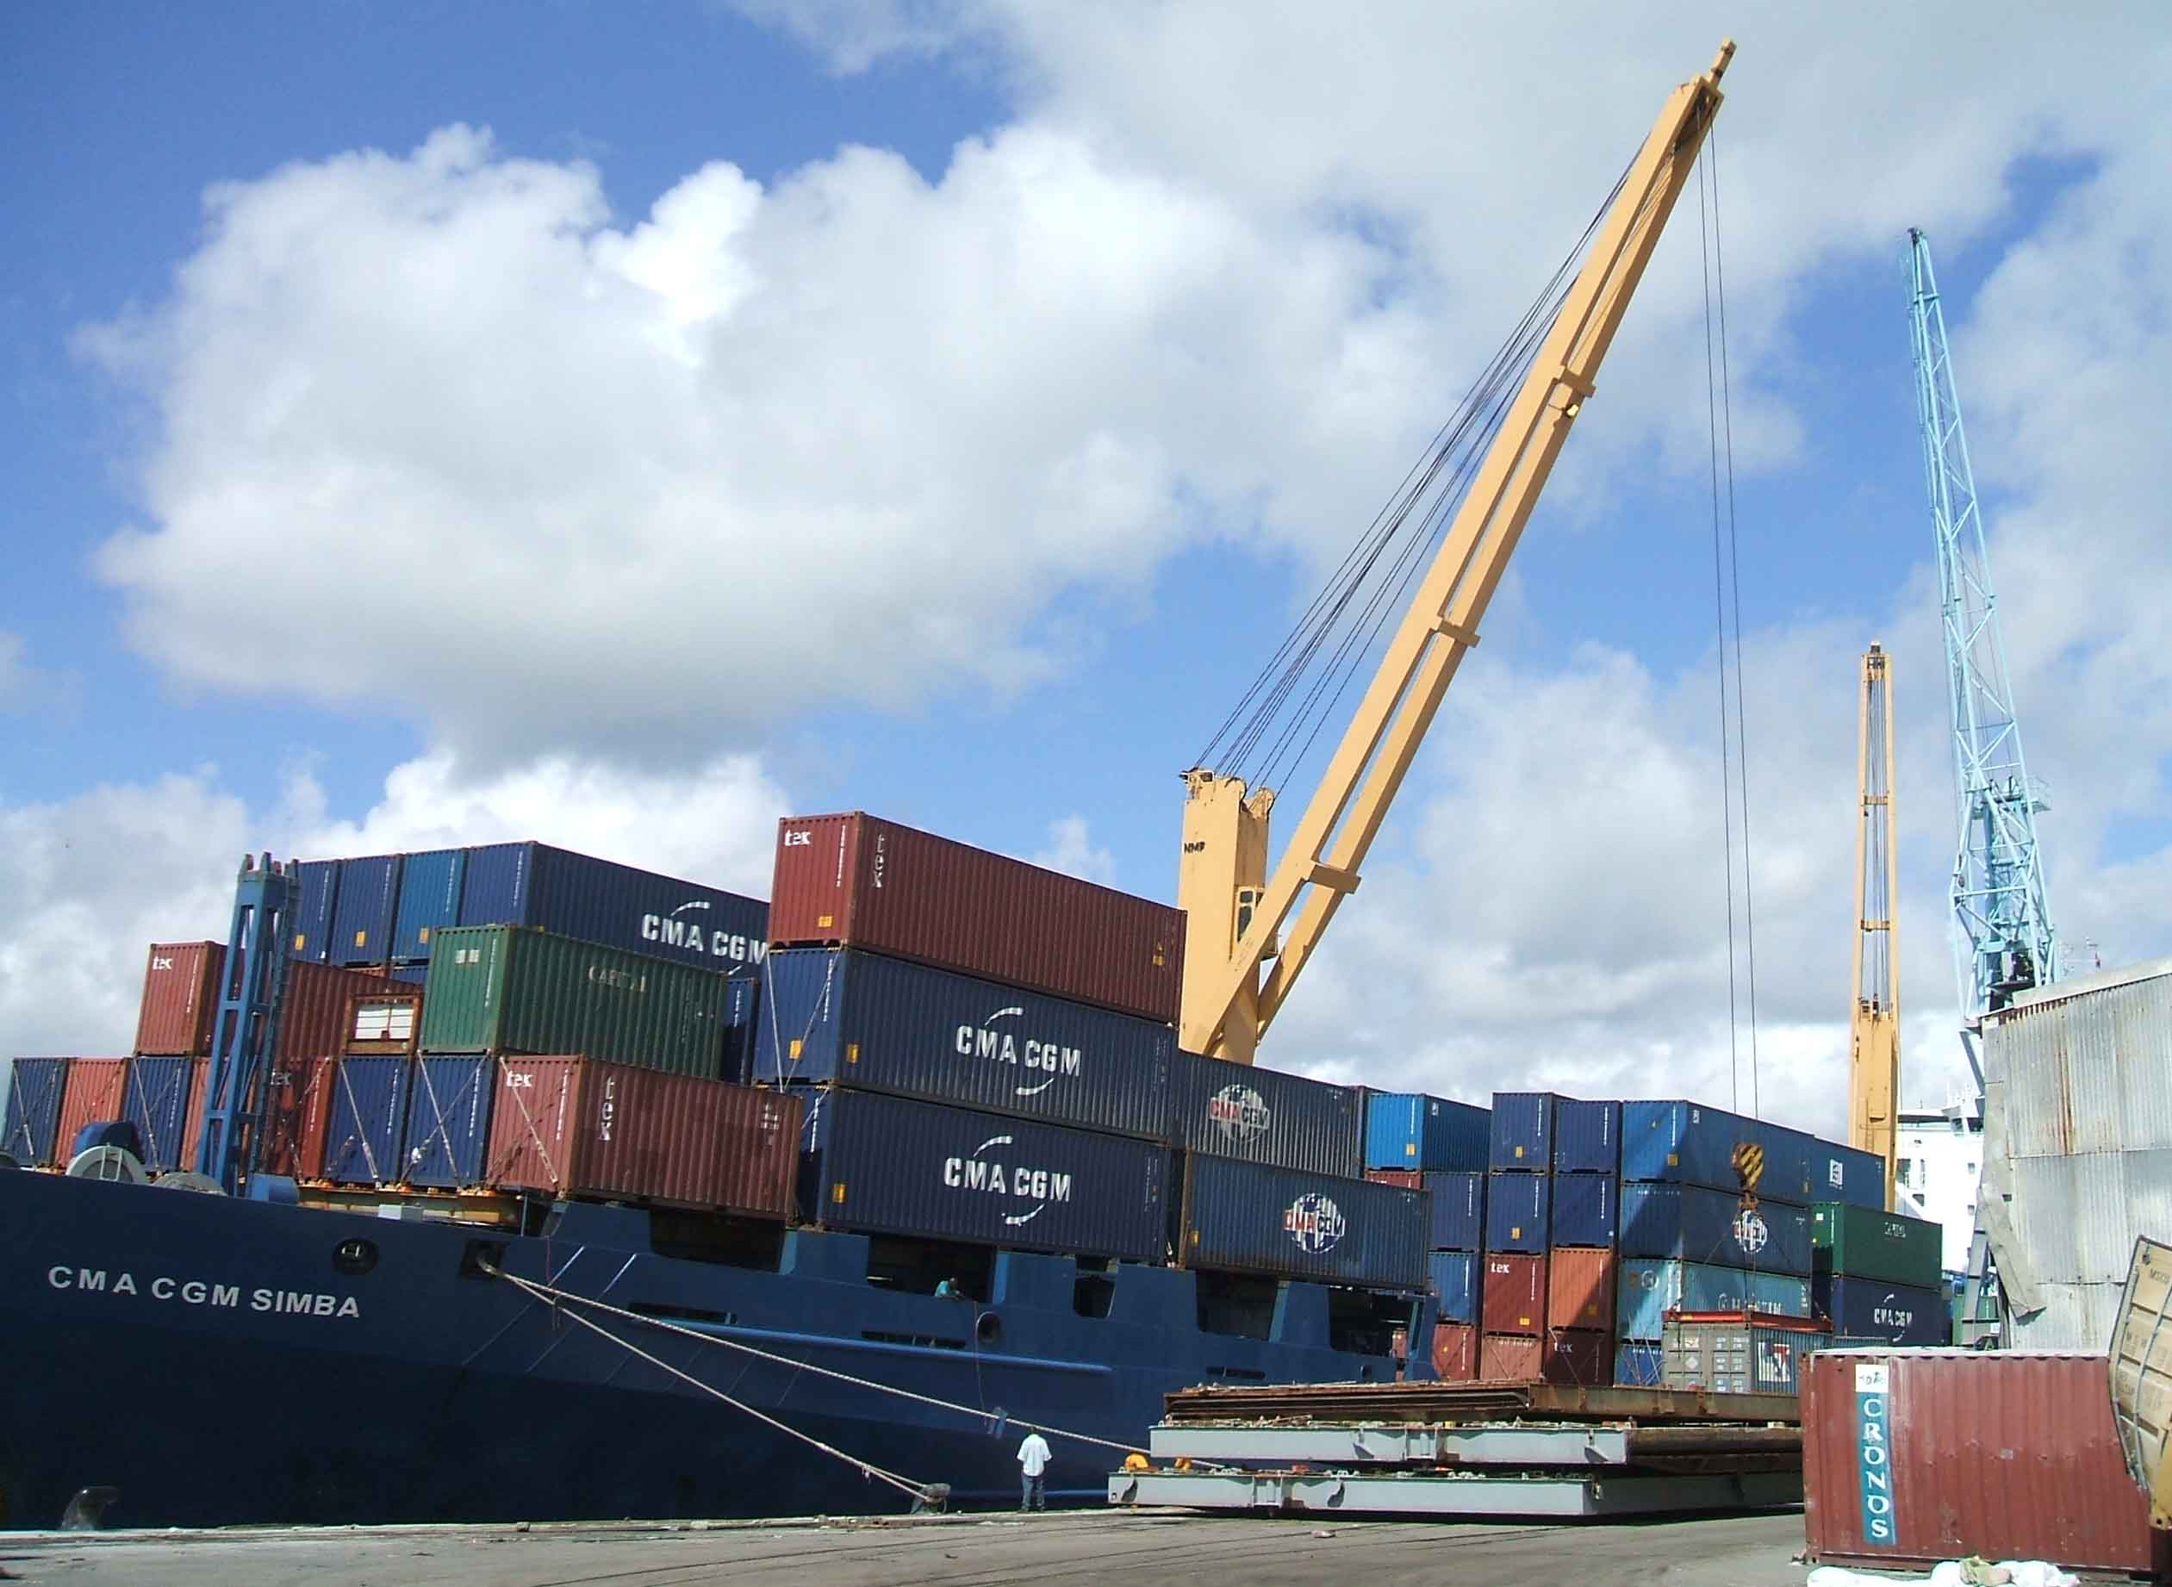
Offloading containers at Mombasa.

Slide 45
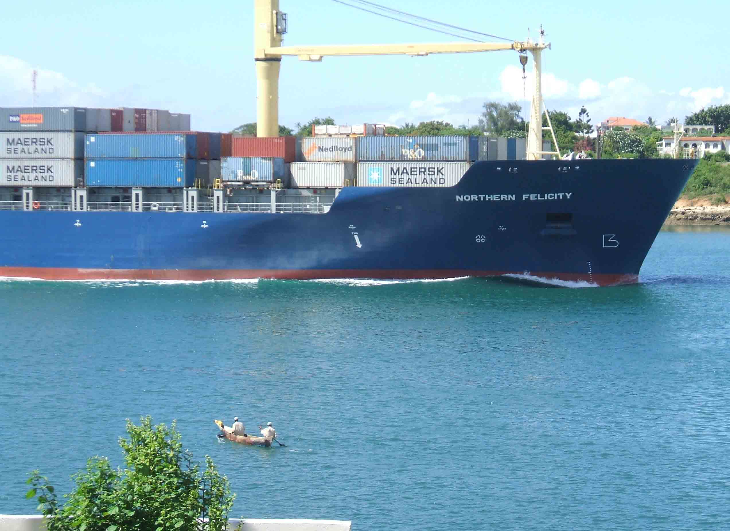
Container ship entering Mombasa harbour.

Slide 46
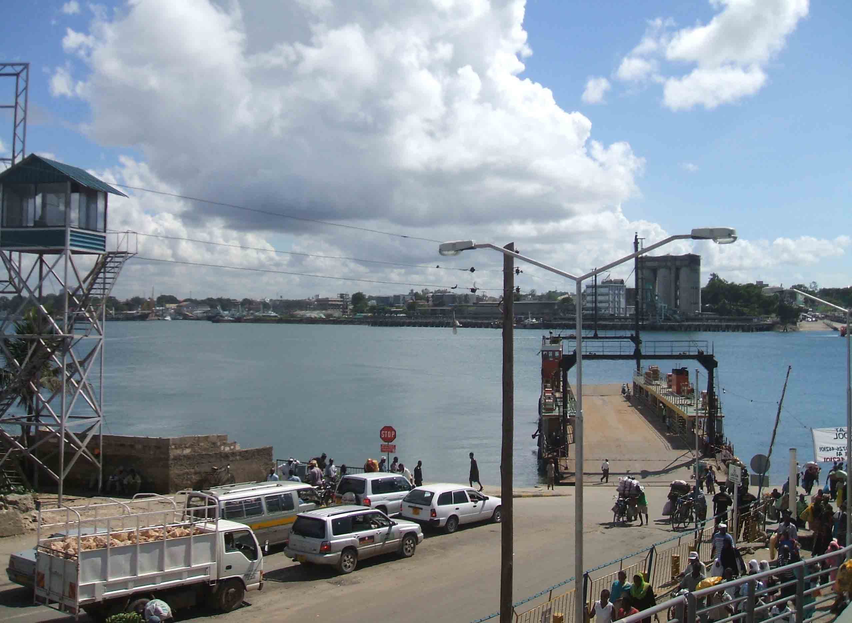
Likoni Ferry line across Mombasa harbour.

Slide 47
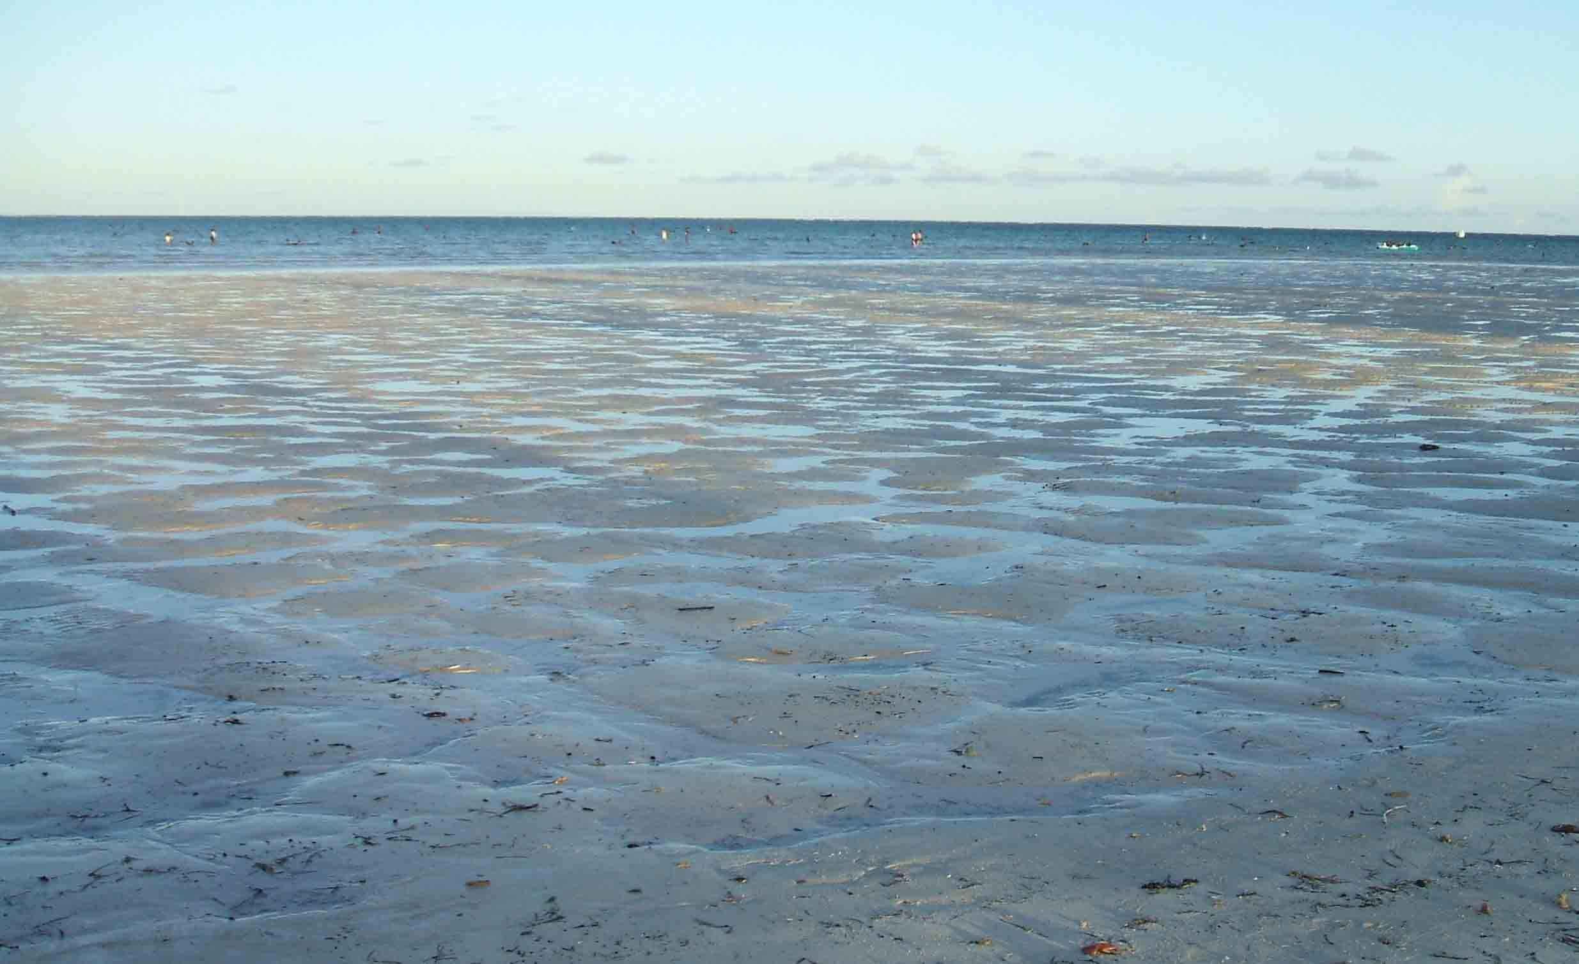
Low tide at Mombasa.

Slide 48
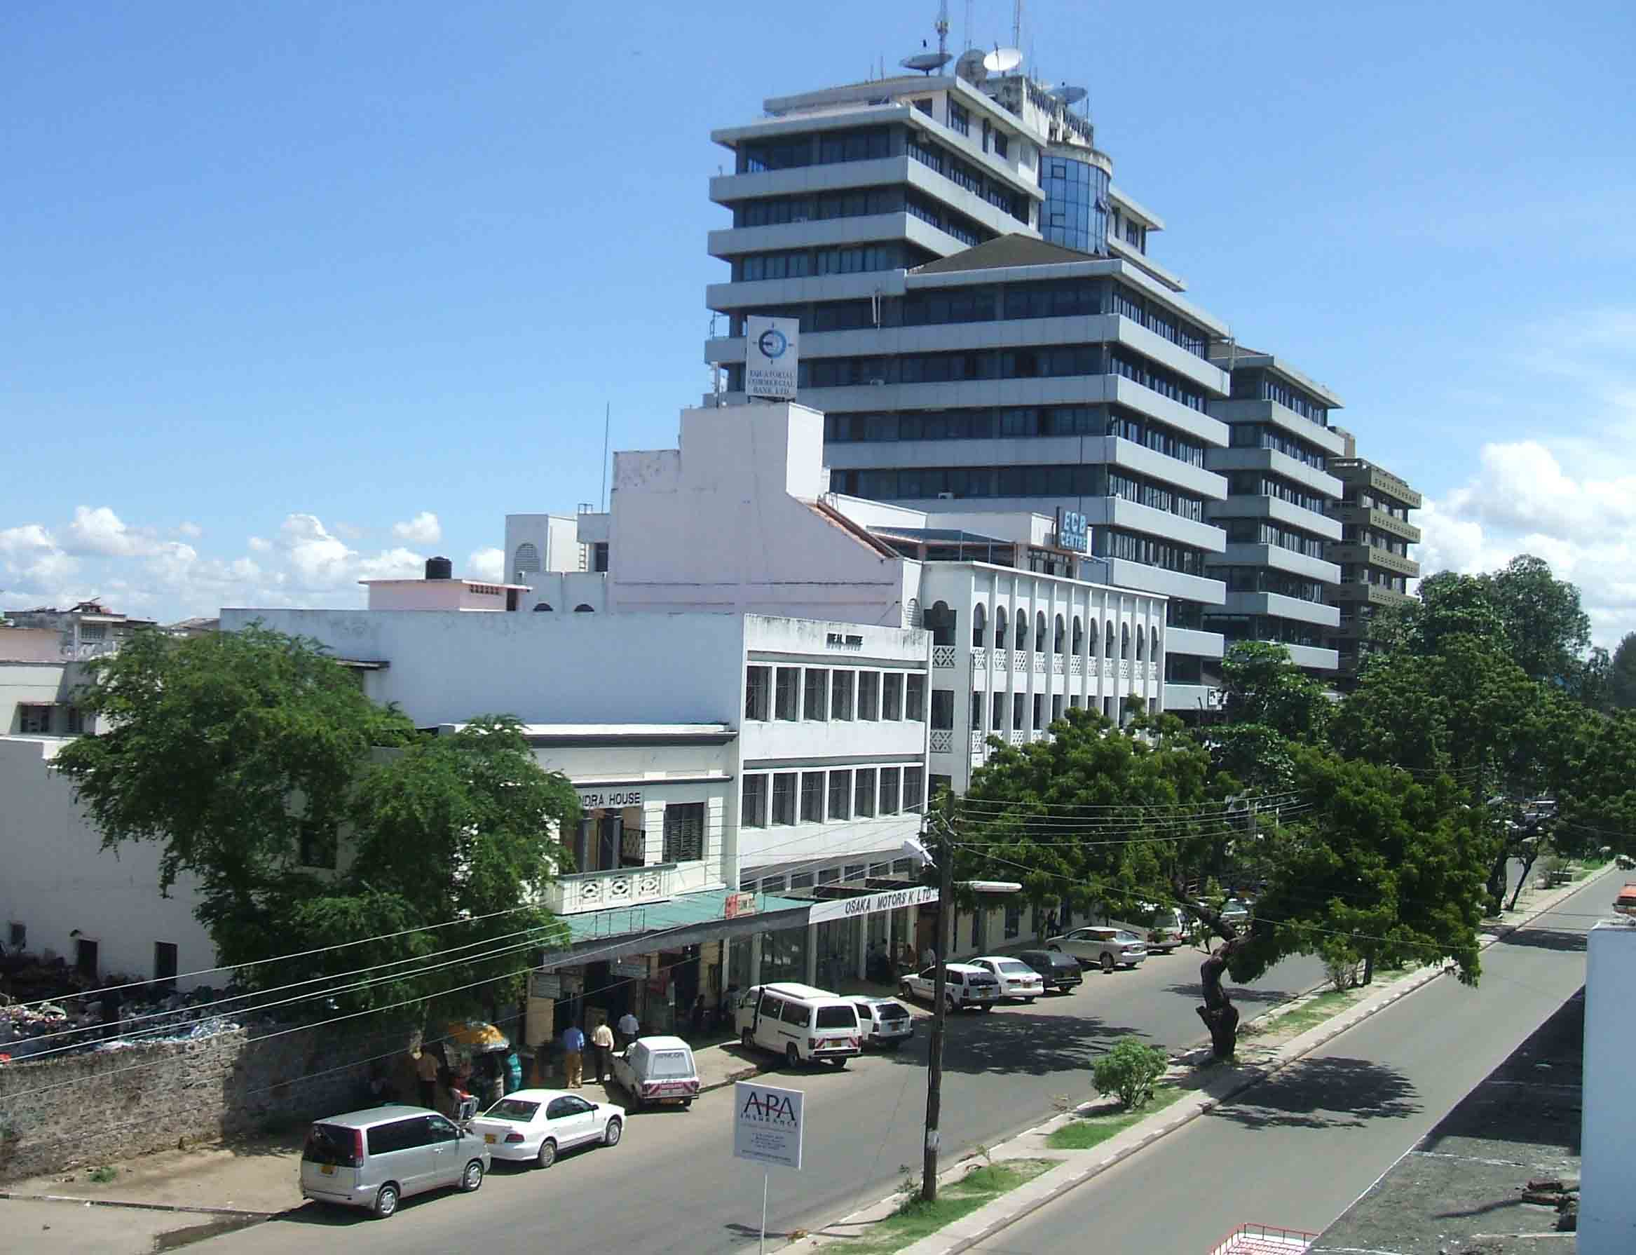
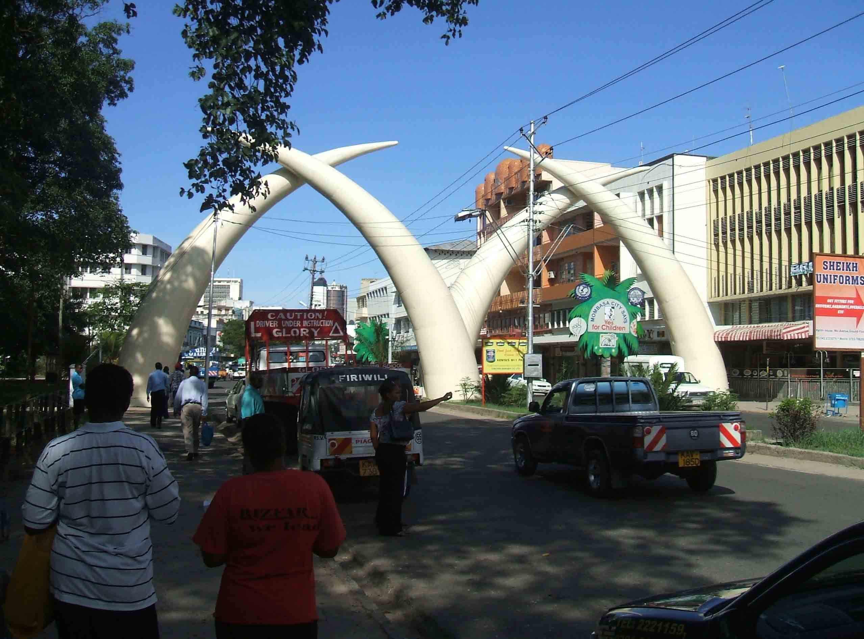
Images of Mombasa City.

Slide 49
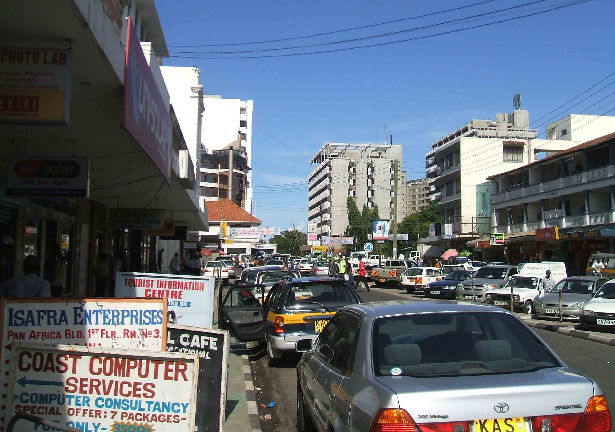
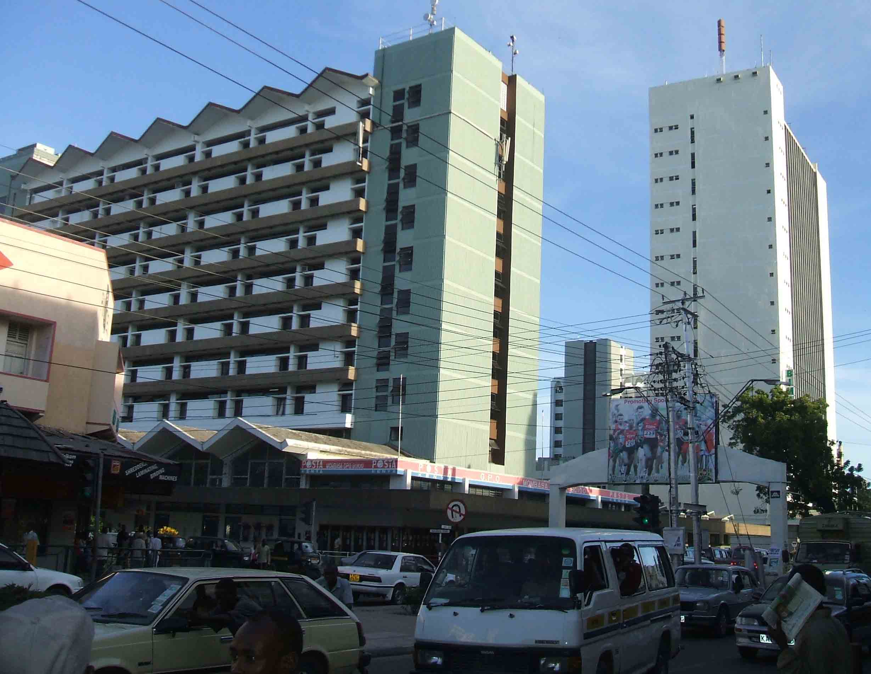
More images of Mombasa city

Slide 50
Comparison between New York port and the port of Mombasa
Similarities between the two harbours
Both have deep waters.
Both have low tidal range.
Both have ice free conditions.
The harbour of Mombasa is sheltered by the headlands of Likoni and Nyali, i.e. both harbours have sheltered waters.

Slide 51
The entrance to both harbours is free from rocks or small islands.
Both harbours have hard rocks on which to construct dock yards on a firm foundation.
The main port or urban centre in both harbours is sited on an island. In New York it is the Manhattan and in Mombasa it is Mombasa Island.

Slide 52
Differences between the two harbours
New York port is much bigger than Mombasa port.
New York port is more technologically advanced than port Mombasa.
The port of New York is affected by fog. Mombasa is seldom affected by fog.
Temperature experienced in Mombasa port is much higher than that in New York.

Slide 53
INDUSTRIAL DEVELOPMENT IN NEW YORK METROPOLITAN AREA
Types of industry in New York metropolitan area;
The clothing and textile industry.
Food processing industry.
Oil refinery industry.
Printing and publishing industry.
Petro-chemical industries.

Slide 54
Factors that have favoured industrial development in New York
Easy transport and communication for the raw materials and products.
There is available skilled labour or high level of manpower.
Available capital and easy access to financial resources.
Availability of advanced technology.
Available market for the products both internally and externally.
Availability of power for running machinery.
Easy access to raw materials.
Available water as an input and a coolant.

Slide 55
Problems of Industrialisation in New York
Limited space for further expansion.
Pollution of air, land and water by industrial waste.
Competition for inputs by industries.
Competition for the market by industries.
The advanced capital intensive techniques or the automation of production has displaced labour leading to unemployment.
Strict government policies against pollution of the environment has made the industries to incur costs or high expenses in order to treat waste and do research in or adapt environmentally friendly techniques.

Slide 56
Measures taken to minimise the problems
Reclamation of the marshlands to create more land for industrial use.
Treatment of industrial waste before disposal.
Seeking alternative sources of inputs or raw materials for investment.
The payment of unemployment benefit to labour that has been displaced or rendered unemployed.
Intensive domestic and international advertising and market research to create more or new markets for the industrial products.
The adoption of environmentally friendly methods of production i.e. through research to avoid the costs of purifying the environment.

Slide 57
Effects of Industrialisation on the environment of New York
It has led to the reclamation of the marshlands and hence environmental degradation.
There has been destruction of the natural vegetation in the process of creating land for industrial use.
There has been industrial air and water pollution.
A lot of noise has been generated by the industries i.e. noise pollution (sonic pollution).
The environment has become more and more artificial with industrial expansion.

Slide 58
Problems affecting New York Metropolitan area.
Pollution.
Traffic congestion.
Growth of slums.
High crime rate and indiscipline.
Unemployment.
Overcrowding and strain of public utilities or social services.
Racist tendencies.
Limited space for further expansion.
Threat of terrorism.
Noise.
Fog.

Slide 59
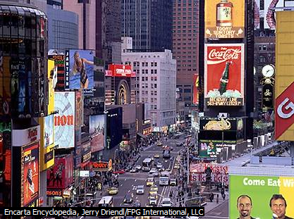
Traffic congestion in Broadway New York city.

Slide 60
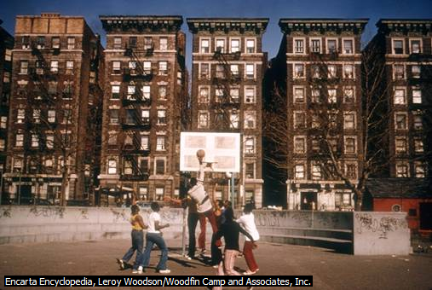
The tenement slums in Harlem

Slide 61
Measures taken to minimize the problems of New York City
For pollution:
The treatment of waste before disposal.
Passing of anti pollutant laws.
Recycling of waste.
Education of people on proper disposal of waste.
For traffic congestion
Construction of more bridges and tunnels.
Construction of more subways and flyovers.
Use of traffic lights and police.

Slide 62
Measures continued.
For accommodation/ slum problems:
Construction of more skyscrapers i.e. vertical expansion.
Urban renewal i.e. demolition and replacement of slums with better structures.
Extension of suburbs i.e. construction of more housing estates in the city outskirts.
Encouraging commuting from the mainland.
For the problem of crime:
Strengthening of the police force and the F.B.I.
Installation of anti theft/ burglar devices e.g. car alarm systems and spy (CCTV) cameras.
Tough legislation (laws) against crime.
Education of the public on how to protect themselves from criminals.

Slide 63
Measures continued.
For the problem of overcrowding and strain on social services:
Aid has been sought from the federal government to provide more public facilities.
Funds have been raised through taxation, fines etc. to provide public utilities.
For the problem of unemployment:
The government has tried to create market for the American goods leading to increased production and thus more jobs.
People are educated and trained in practical skills and encouraged to engage in self employment.
Unemployment benefits are given to the jobless.

Slide 64
Measures continued.
To reduce on racist tendencies:
Anti racist laws have been passed.
People have been encouraged to live together in harmony regardless of race by religious and civil rights groups
To solve the problem of limited space for expansion:
Vertical expansion has been encouraged ie the construction of skyscrapers.
Reclamation of the marshlands to create more land.
For the Threat of terrorism:
Conducting security checks.
Rounding up and investigating suspected terrorists.
Engaging in national and international anti-terrorism campaign.

Slide 65
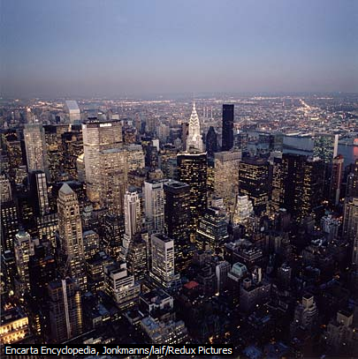
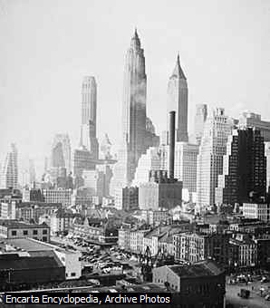
Sky scrapers – vertical expansion

Slide 66
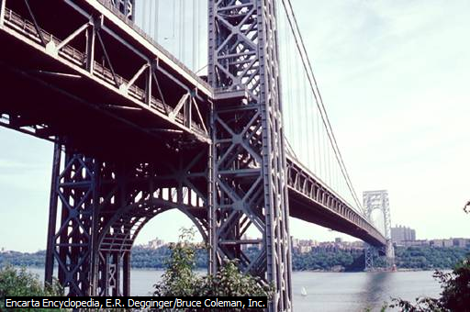
George Washington Bridge across Hudson River.

Slide 67
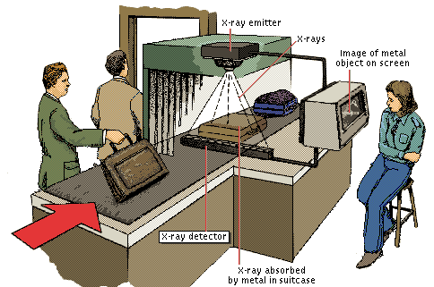
X-ray in Airport security

Slide 68
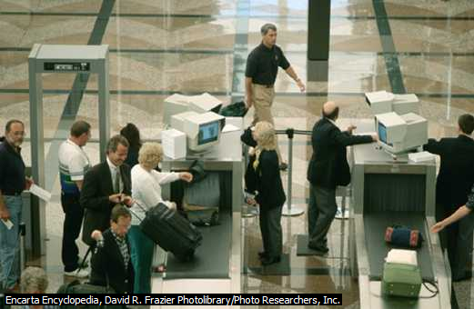
Airport security check point

Slide 69
Disadvantages of the site of New York metropolitan area
The many islands require the construction of bridges and tunnels to be connected which is quite expensive.
There is limited space for horizontal expansion.
The lowlands were marshy and required expensive reclamation.
It’s believed that the Manhattan is slowly sinking because of many heavy buildings.

